Slide 1
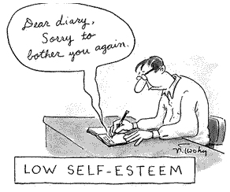
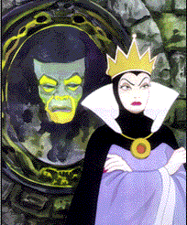
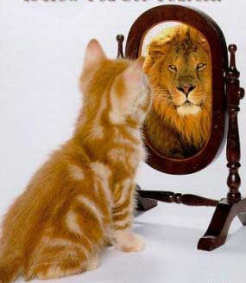
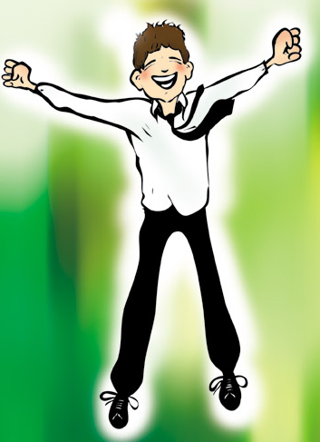
Self-Esteem

Slide 2
Outline
The importance of self-esteem
What self-esteem is… and is not
The paradox of self-esteem
Toward a new understanding
  Dependent self-esteem
  Independent self-esteem
  Unconditional self-esteem
Enhancing self-esteem

Slide 3

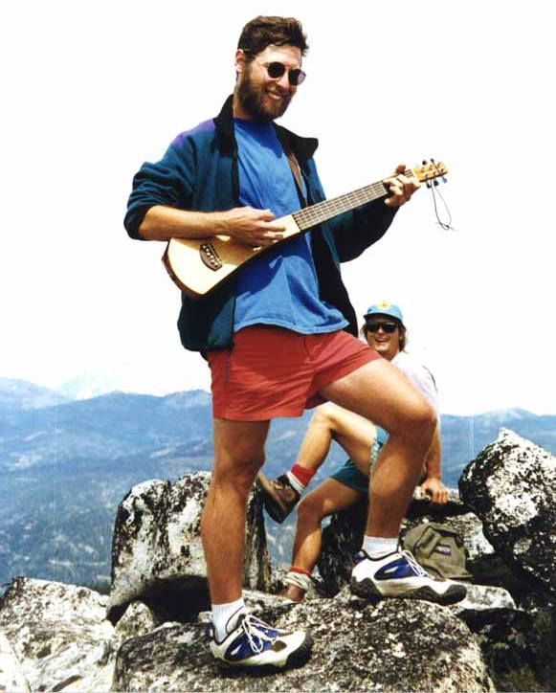
Definition
“Self-esteem is the disposition to experience oneself as competent to cope with the basic challenges of life and as worthy of happiness.”
Nathaniel Branden

Slide 4
The Importance of Self-Esteem
Of all the judgments we pass in our lives, none is as important as the one we pass on ourselves. Nathaniel Branden
The greatest evil that can befall man is that he should come to think ill of himself. Goethe

Slide 5
High Self-Esteem
Mental Health
Quality of relationships
Success
Social effectiveness
Happiness

Slide 6
Low Self-Esteem
Anxiety
Depression
Psychosomatic symptoms
Underachievement

Slide 7
Nathaniel Branden —
The immune system of consciousness
Bednar and Peterson —
Underlying cause of most emotional and behavioral problems
California Task Force —
Social vaccine

Slide 8
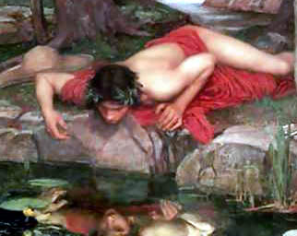
Criticism
Egotism (arrogance and conceit)
“The person who feels weak becomes a bully, the inferior person a braggart; a flexing of muscles, much talk, cockiness, an endeavor to brazen it out, are symptoms of covert anxiety in a person or a group.”
Rollo May

Slide 9
Criticism
Egotism (arrogance and conceit)
Unrealistic evaluation (harms performance)

Slide 10
Salvaging Self-Esteem’s Self-Esteem
What self-esteem is not —
A product of empty reinforcement
Pseudo self-esteem
What self-esteem is —
Founded in reality
Product of hard work

Slide 11
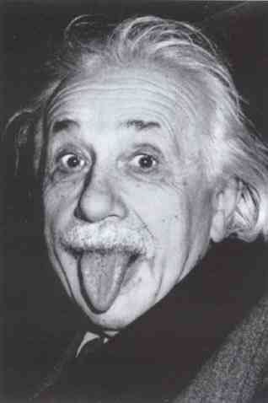
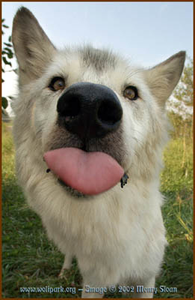

More Criticisms of Self-Esteem
Anti-social behavior —
Aggressive, uncooperative
Paradox of self-esteem

Slide 12
A New Formulation
Dependent self-esteem
Independent self-esteem
Unconditional self-esteem

Slide 13
Dependent Self-Esteem
Worthiness —
Other-determined
Competence —
Other-comparison

Slide 14
Independent Self-Esteem
Worthiness —
Self-determined
Competence —
Self-Comparison

Slide 15
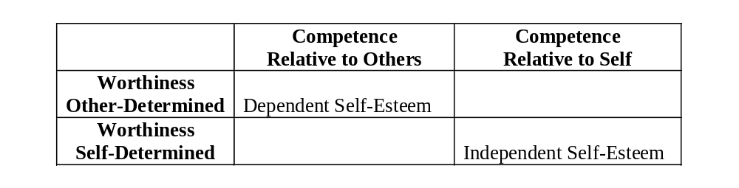

Slide 16
Unconditional Self-Esteem
Worthiness —
Not contingent
Competence —
Interdependent

Slide 17
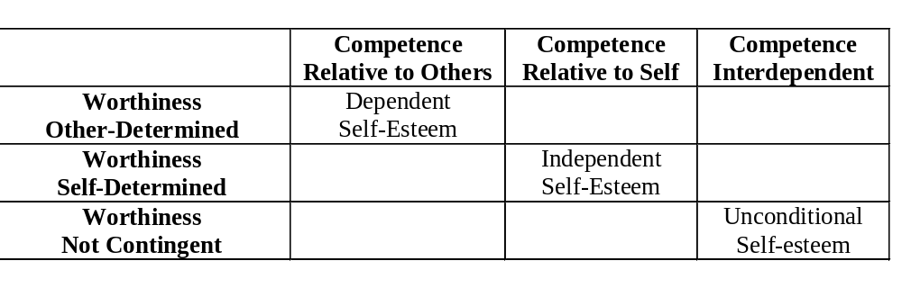

Slide 18
The Importance of Being Independent
Moral Behavior
  True to principles
  Empathy
Better cognitive performance
  Creative thinking
  Commitment to continuous learning
Increased Happiness
  Calmness
  The joy of self-expression

Slide 19
Research Results
Self-Esteem Stability
  Kernis (1995)
  Ben-Shahar (2000)
Happiness and Flow
  Christino (2002)
Narcissism, Generosity, Hostility
  Ben-Shahar (2004)
Perfectionism
  Ignaczyk and Richey (2003)

Slide 20
The Case of Relationships
“Differentiation is your ability to maintain your sense of self when you are emotionally and/or physically close to others—especially as they become increasingly important to you. Differentiation permits you to maintain your own course when lovers, friends, and family pressure you to agree and conform. Well-differentiated people can agree without feeling like they’re ‘losing themselves,’ and can disagree without feeling alienated and embittered.”
David Schnarch (1997)

Slide 21
Cultivating
Independent and Unconditional
Self-Esteem

Slide 22
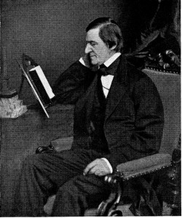
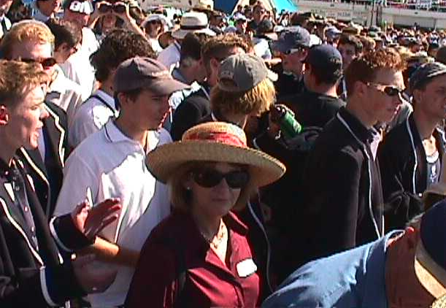
“It is easy in the world to live after the world’s opinion; it is easy in solitude to live after our own; but the great man is he who in the midst of the crowd keeps with perfect sweetness the independence of solitude.” Ralph Waldo Emerson

Slide 23
Change
Attitude
Behavior

Slide 24
Enhancing Self-Esteem
Induce calm
Slave to passions
Finding flow
Coping
Humble behavior
Taking time

Slide 25
Stage Model
Stage 1
  Automatic reaction
  Conformity
  Dependent self
Stage 2
  Deliberate reflAction
  Self reliance
  Independent core self

Slide 26
Enhancing Self-Esteem
Induce calm
Slave to passions
Finding flow
Coping
Humble behavior
Taking time
Integrity

Slide 27
Integrity Treatment
Being known versus validated (Schnarch, 1997)
  Express not impress
  Assert yourself
Gradually expanding integrity
  From journaling to loved-one to world
  From day to week to life-long
Truth sets us free

Slide 28
Your true potential lies way, way down in the depths of your soul… in the pit of your stomach, past your knowledge, beyond your nervousness, and buried under your fears and anxieties. As hidden as it may be, it is still there. I know it’s there because I’ve felt it before, and I know it’s there in others too because I’ve seen others perform miracles. There is a faint glow of unparalleled potential in all of us, and when we find it — it shines.
Melissa Christino

Slide 29
Bibliography and Recommendations
Bandura, A. (1997). Self-efficacy: The exercise of control. W.H. Freeman and Company: New York.
Bednar, R. L. and Peterson, S. R. (1995) Self Esteem: Paradoxes and Innovations in Clinical Theory and Practice. (2nd edition). American Psychological Asssociation.
Coopersmith, S. (1967). The antecedents of self-esteem. New York: W.H. Freeman.
Crocker, J., Luhtanen, R. K., Bouvrette, S. (2003). “Contingencies of self-worth in college students: theory and measurement.” Journal of Personality and Social Psychology. 85, 894-908.
Kernis, M. H. (Ed.). (1995). Efficacy, agency, and self-esteem. New York: Plenum.
Locke, E. A., McClear, K., Knight, D. (1996). “Self esteem and work.” In C. Cooper & I. Robertson (Eds), International Review of Industrial & Organizational Psychology. Chichester, England: Wiley Ltd.
Swann, W. B., Jr. (1997). The trouble with change: Self-verification and allegiance to the self. Psychological Science, 8, (3), 177-180.

